Slide 1
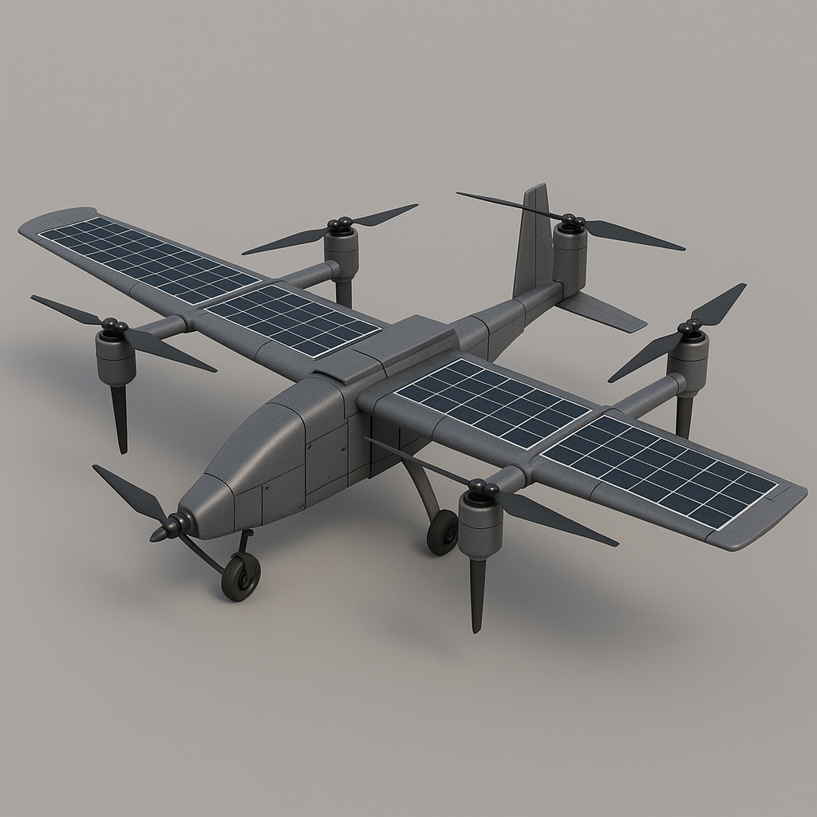
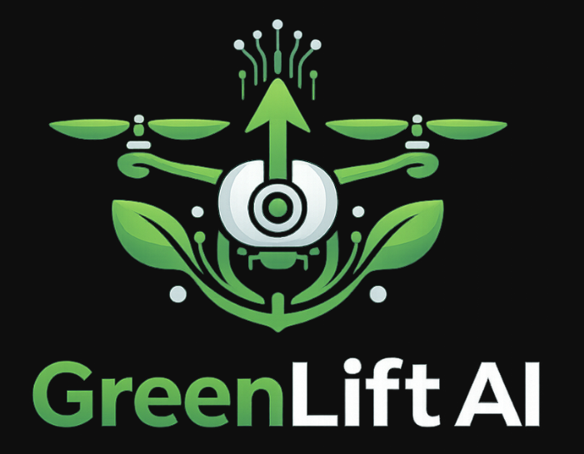

GreenLift AI
Intelligent VTOL Drone Delivery Ecosystem for SMEs
• Team Phantom • Pabna University of Science and Technology
Contact: armanislam527@gmail.com | +8801521751005
Portfolio: Go To Link
Notes:
Click to add Notes

Slide 2


Meet Team Phantom
Four innovators from Pabna University driving intelligent logistics transformation across Bangladesh.
Arman Islam
Technical & Idea Supporter
WRO 2025 participant
Autonomous systems specialist
Embedded system
Good hand on Robotics
GitHub | Linkedin | Portfolio
Notes:
Click to add Notes

Slide 3



The Challenge for Bangladesh's SMEs
Small and medium enterprises face critical logistics barriers that limit growth and sustainability potential across the nation.
Last-Mile Inefficiency
89% of SMEs struggle with costly, unreliable final-delivery logistics that drain operational budgets.
Monsoon Vulnerability
91% report severe delivery delays during rainy seasons, creating supply chain chaos and customer dissatisfaction.
Cost Burden
Logistics consume 18-25% of SME budgets, leaving limited resources for growth, innovation, and sustainable practices.
Data Blindness
73% lack business intelligence tools, missing critical insights on demand patterns, inventory optimization, and customer behavior.
Notes:
Click to add Notes

Slide 4
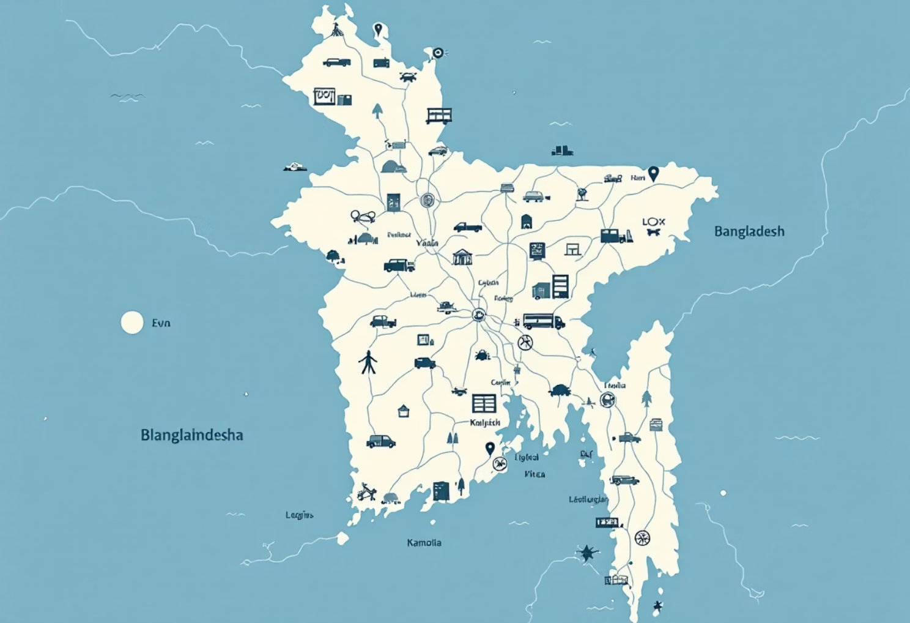
Market Opportunity & Growth Potential
Bangladesh's SME sector represents an extraordinary opportunity for intelligent logistics innovation:
10.4 Million SMEs
Representing the economic backbone of Bangladesh
78% Underserved
Located in areas with inadequate logistics infrastructure
Explosive E-Commerce Growth
Rapidly expanding digital retail sector demanding reliable solutions
Market Size: $10+ billion logistics opportunity
Sustainability Imperative
Growing demand for carbon-neutral delivery aligned with climate goals
Notes:
Click to add Notes

Slide 5








GreenLift AI: The Integrated Solution
A comprehensive hardware-software ecosystem designed specifically for SME logistics transformation.
Solar-Powered Drones
Zero-Carbon Delivery
Renewable energy eliminates fuel costs and environmental impact
Sustainable operations aligned with climate commitments
One-Time Setup
AI Dashboard
Minimal investment with rapid ROI for budget-conscious SMEs
Real-time intelligence for smarter business decisions
Notes:
Click to add Notes

Slide 6
AI Integration & Competitive Advantage
Machine learning powers intelligent decision-making across the entire delivery ecosystem, transforming data into actionable insights.
1
Demand Forecasting
Predictive analytics anticipate customer needs and optimize inventory levels proactively.
2
Route Optimization
AI calculates fastest, most efficient delivery paths reducing time and energy consumption.
Autonomous Operations
3
Automated decision-making reduces manual oversight while maintaining safety and compliance standards.
Smart Inventory
4
Real-time inventory synchronization prevents stockouts and reduces wasteful overstock scenarios.
Personalized Experiences
5
Customer-centric insights enable tailored services that build loyalty and competitive differentiation.
Notes:
Click to add Notes

Slide 7
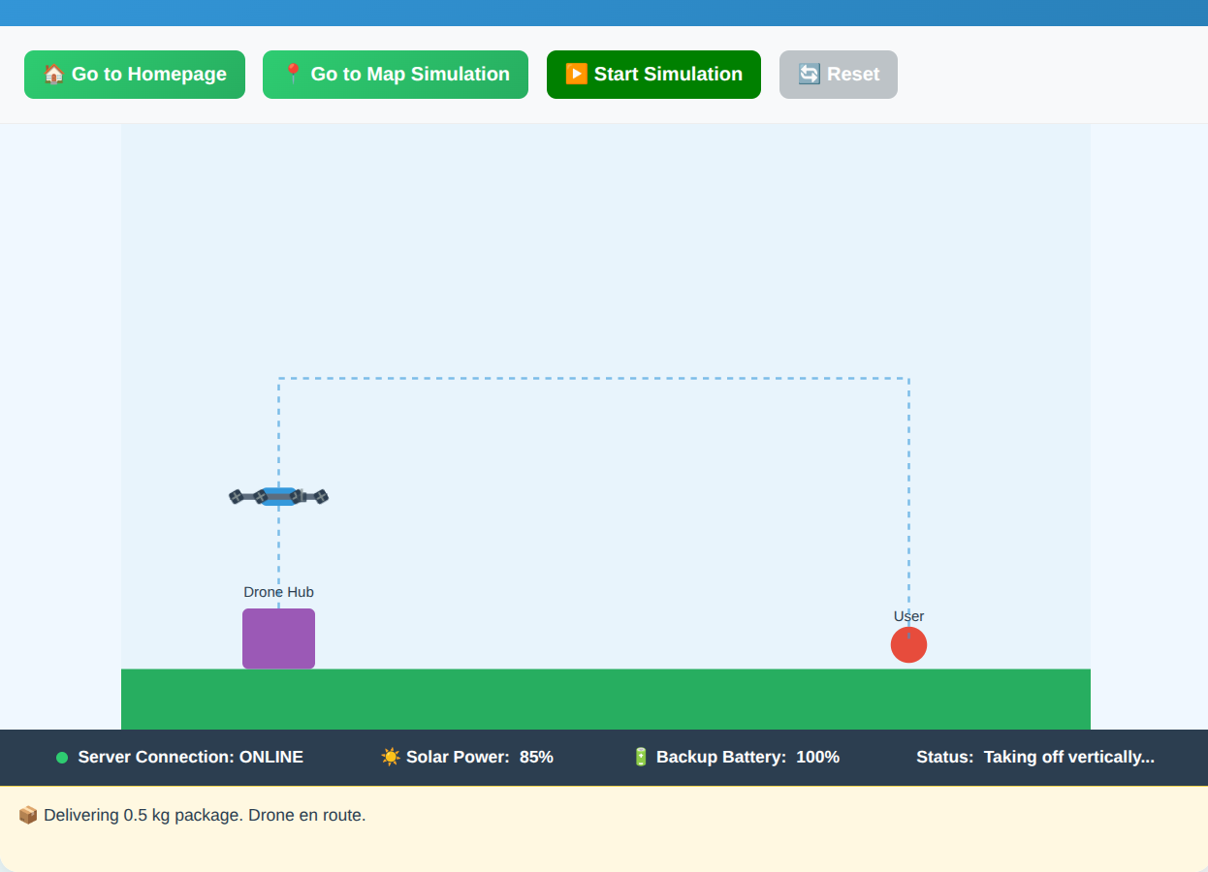








Product Demo & Key Features
GreenLift AI brings intelligent drone delivery to life through an intuitive, AI-powered platform. Watch as our system orchestrates real-time operations, from dispatch to delivery confirmation.
Real-Time Tracking
Monitor every flight with live GPS positioning and predictive arrival estimates
SME Dashboard
Intuitive control center for scheduling, dispatching, and performance monitoring
Automated Scheduling
AI-optimized delivery routes reduce delays and maximize daily capacity
Click the link below or
scan the QR code
Business Analytics
Comprehensive reports on efficiency, profitability, and customer satisfaction
Simulate
Notes:
Click to add Notes

Slide 8
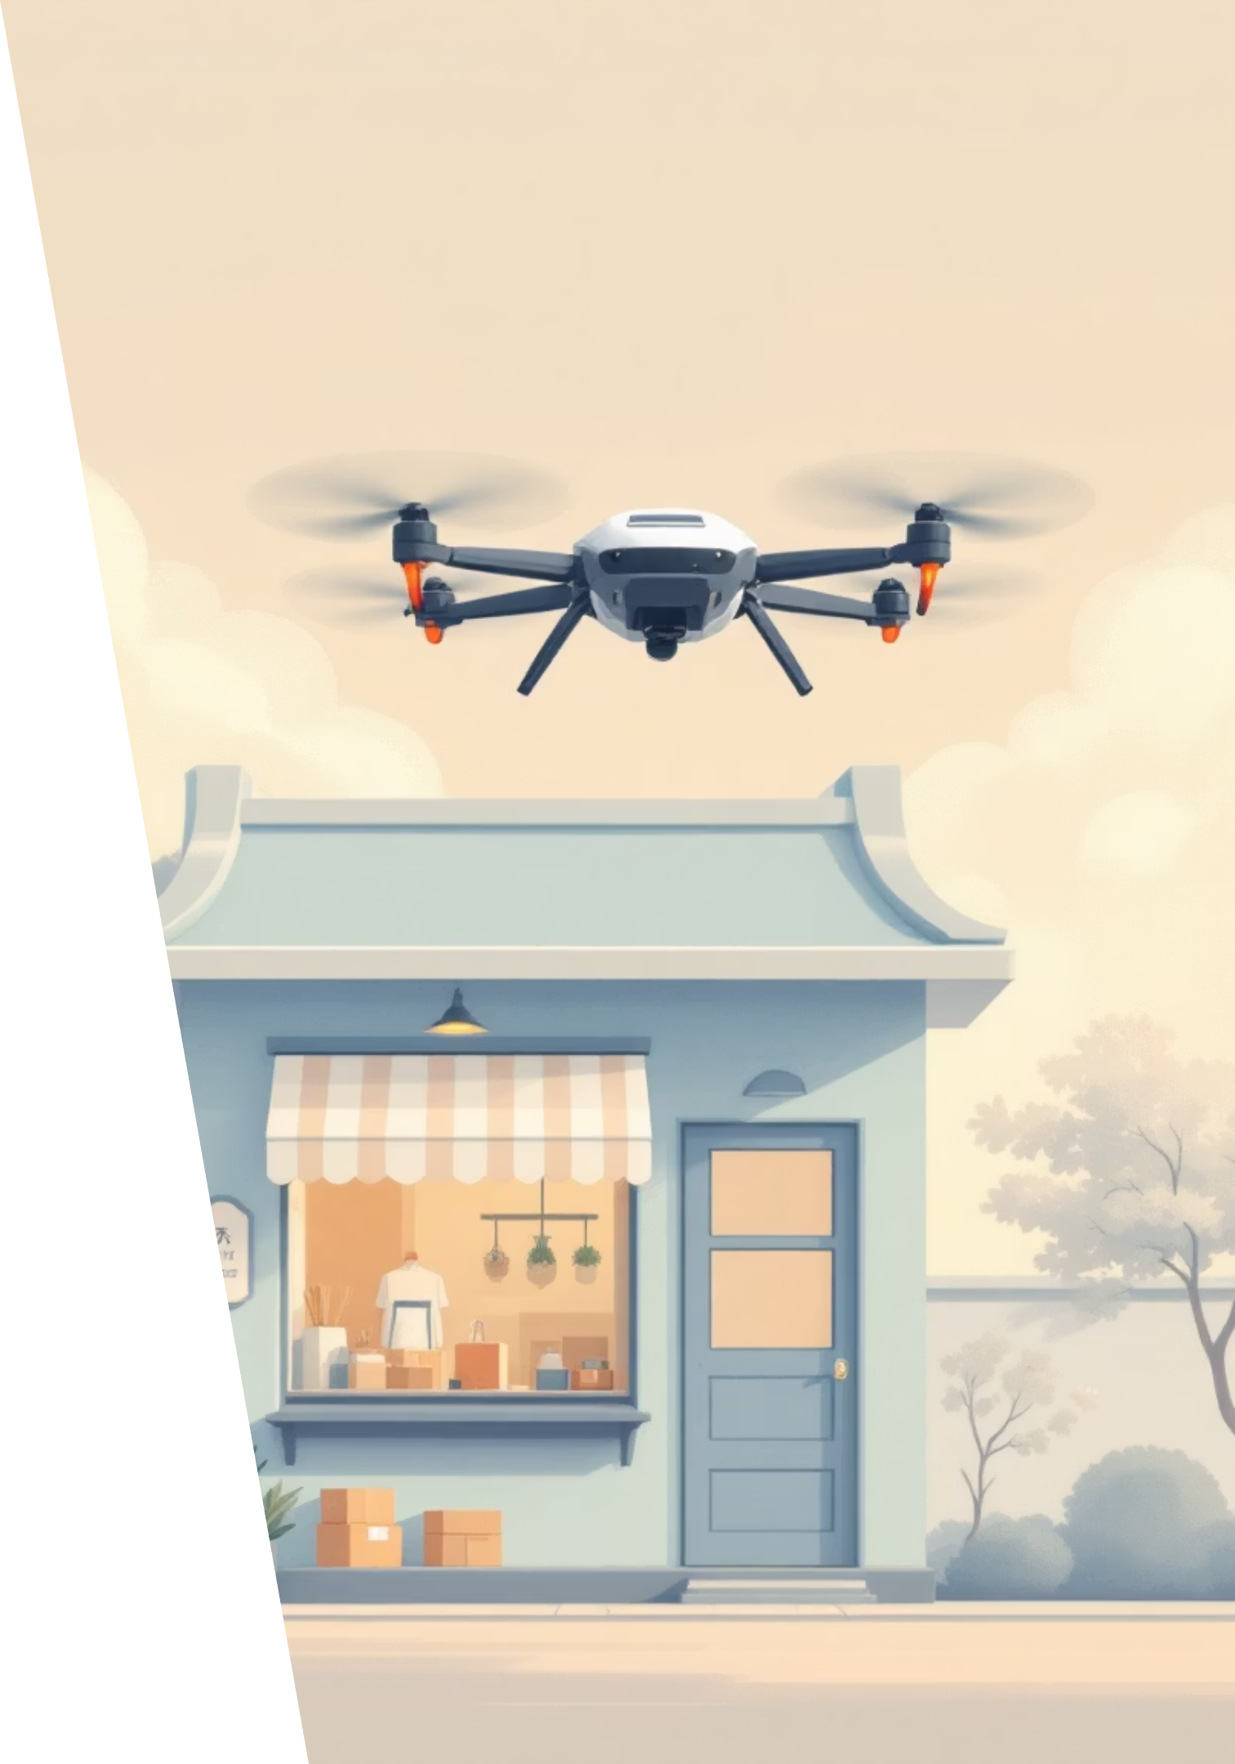
Unique Value Proposition
GreenLift AI stands apart by combining environmental responsibility with unmatched operational efficiency. What makes us different isn't just technology—it's a fundamentally better business model for SMEs.
Zero-Carbon Operations
Solar-powered fleet eliminates fuel costs and carbon emissions, aligning with global sustainability goals while boosting brand value
No Wage Burden
One-time equipment investment replaces ongoing driver salaries. Autonomous operations reduce labor dependency and improve margins
Integrated AI Analytics
Predictive insights optimize delivery routes, weather planning, and demand forecasting in ways traditional logistics cannot match
Weather Resilience
Advanced sensors and AI modeling enable safe operations in challenging conditions where traditional methods struggle
The Result: Faster deliveries, lower costs, competitive advantage—all without environmental compromise.
Notes:
Click to add Notes

Slide 9




Business Model & Revenue Strategy
GreenLift AI generates revenue through multiple streams, creating predictable income while remaining flexible to SME budgets and operational scales.
Pay-Per-Delivery
AI Dashboard Subscription
15–30 BDT per delivery
500–2,000 BDT/month
Variable revenue scales with transaction volume, aligned with customer success
Recurring revenue for analytics, scheduling, and premium features
Strategic Partnerships
Fleet Leasing
Revenue sharing with e-commerce and logistics platforms
Equipment-as-a-Service model
Maintenance and support included; lowers customer capital requirements
Co-branded solutions expand reach and market credibility
Notes:
Click to add Notes

Slide 10
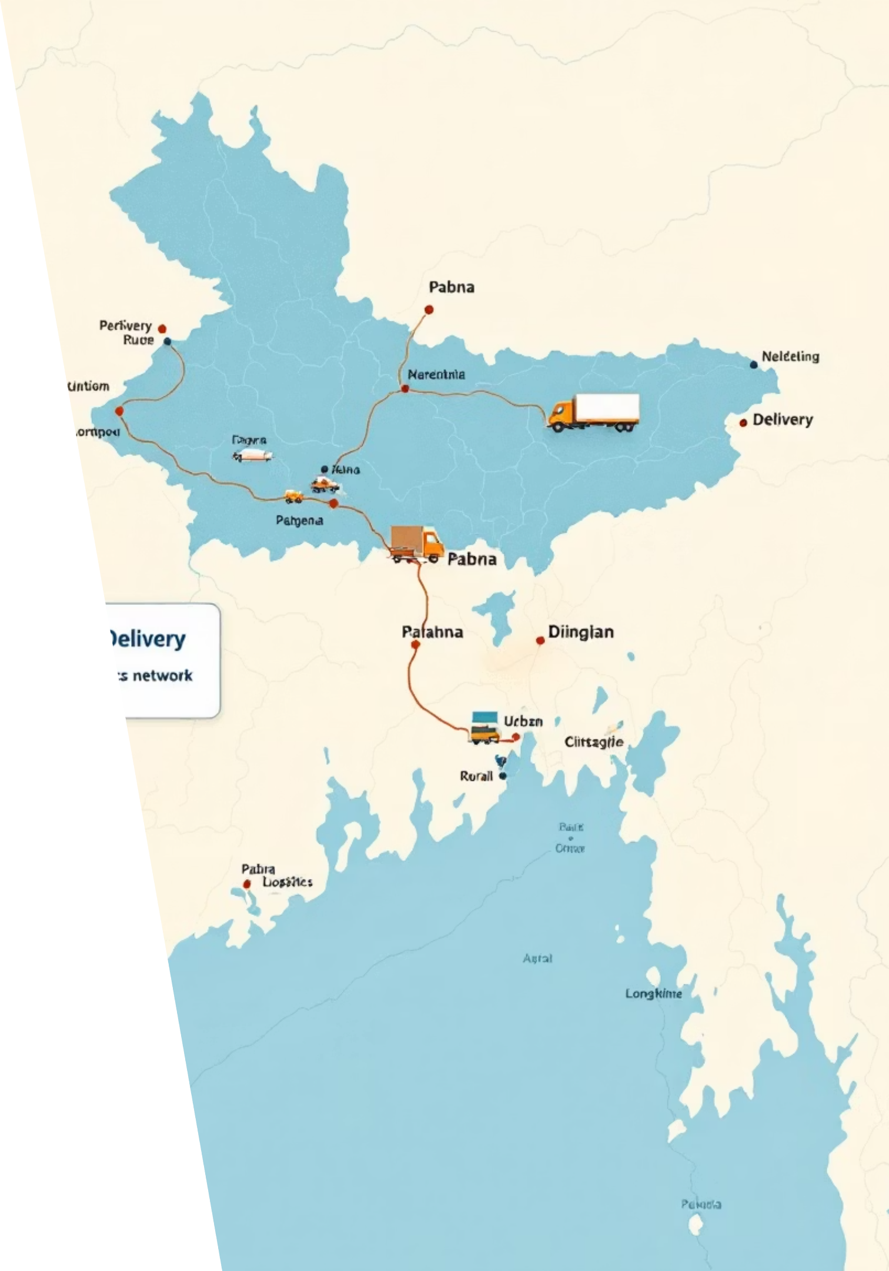


Go-to-Market Strategy
Our phased approach targets high-density SME clusters while building proof-of-concept and regulatory credibility. Rapid scaling follows successful pilot validation.
Pilot Launch
Pabna district: Deploy 10–15 drones across 50 SME partners
Strategic Partnerships
Align with business associations, e-commerce platforms, and local retailers for distribution and credibility
Digital Marketing
Targeted campaigns, case studies, and influencer partnerships within SME networks
Referral Program
Incentivize early adopters to drive organic growth and peer adoption
Notes:
Click to add Notes

Slide 11
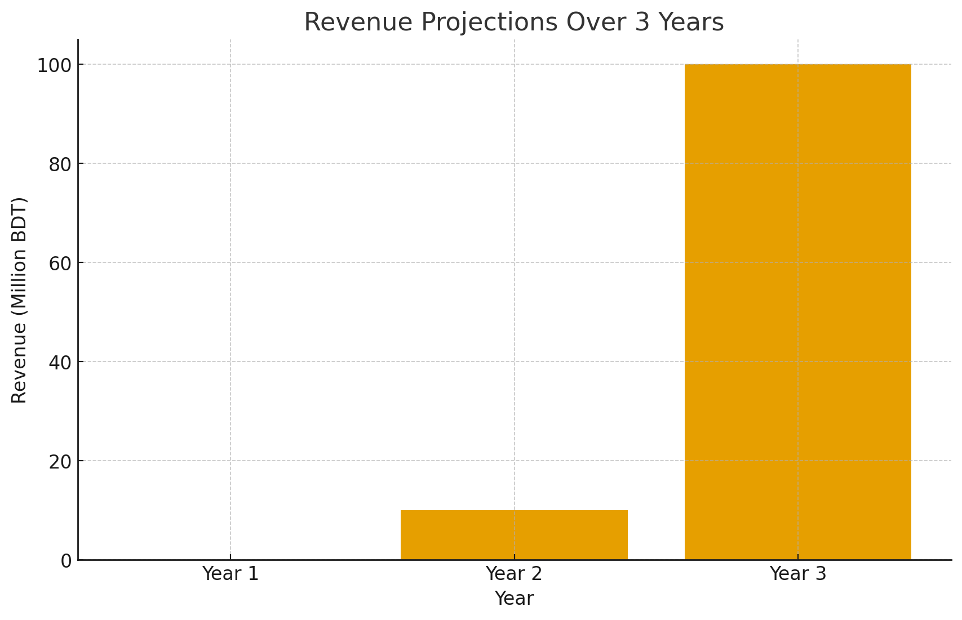
Financial Projections
Conservative growth projections demonstrate clear path to profitability and scale. Based on pilot results and market adoption rates.
Financial Projection Overview:
Year 1: No revenue —
focus on R&D
drone testing
BVLOS regulatory clearance
Operational piloting.
Year 2: Revenue begins with:
SME logistics contracts
pharmacy cold-chain delivery
campus cargo corridors
and initial partner onboarding.
Year 3: Commercial scale-up with:
expanded fleet & multi-district
autonomous drone corridors.
Funding Target: 10M BDT to accelerate development, pilot scaling, and team expansion across Q1–Q3 2026.
Notes:
Click to add Notes

Slide 12

Next Steps & Our Ask
1
Prototype Completion
Final hardware integration and software refinement by end of Q2 2024
2
Field Testing & Validation
Real-world performance testing with regulatory bodies and select partners
3
Regulatory Approval
Secure airspace permits and operational certifications in Bangladesh
4
Pilot Launch
Full deployment in Pabna with 50 SME partners by Q4 2024
Our Ask: We are seeking 10M BDT investment to accelerate prototype completion, regulatory approval, and pilot execution. This capital directly funds our path to market leadership across Bangladesh and positions GreenLift AI as the definitive SME drone delivery platform in South Asia.
Contact & Learn More: armanislam527@gmail.com
Notes:
Click to add Notes

